Slide 1
Development of Genomic Resources for Management of Verticillium wilt of Potato

Slide 2
Material and Methods
Host | Evaluated |  | Validated
 | DEGs | Comparisons | DEGs | Comparisons
Solanum tuberosum | 11 | 14 | 9 | 12
Brassica juncea | 9 | 18 | 5 | 10
Mint | 3 | 6 | 3 | 4
Verticillium dahliae | 5 | 5 | 4 | 4
Total | 28 | 43 | 21 | 30
Host
Solanum tuberosum
Brassica juncea
Pathogen
Vd-653
Vd-111
Control
Sample collection
RNA extraction and cDNA synthesis
Gene selection and primer design
qRT-PCR: 3 biological and technical replicates
Fold change calculation: delta delta Ct method

Slide 3
Genes with Inconsistent Results
Opposite results
Brassica genes with inconsistent amplification across treatments
Gene | Avg. Ct
 | Vd-653 | Vd-111 | Control
Bj-UVB31_ARATH | 29.8 (1 sample amplified) | 30.62 | No amplification
Bj-Cluster-15354.125147 | No amplification | 34.14 (1 sample amplified) | 33.23

Slide 4
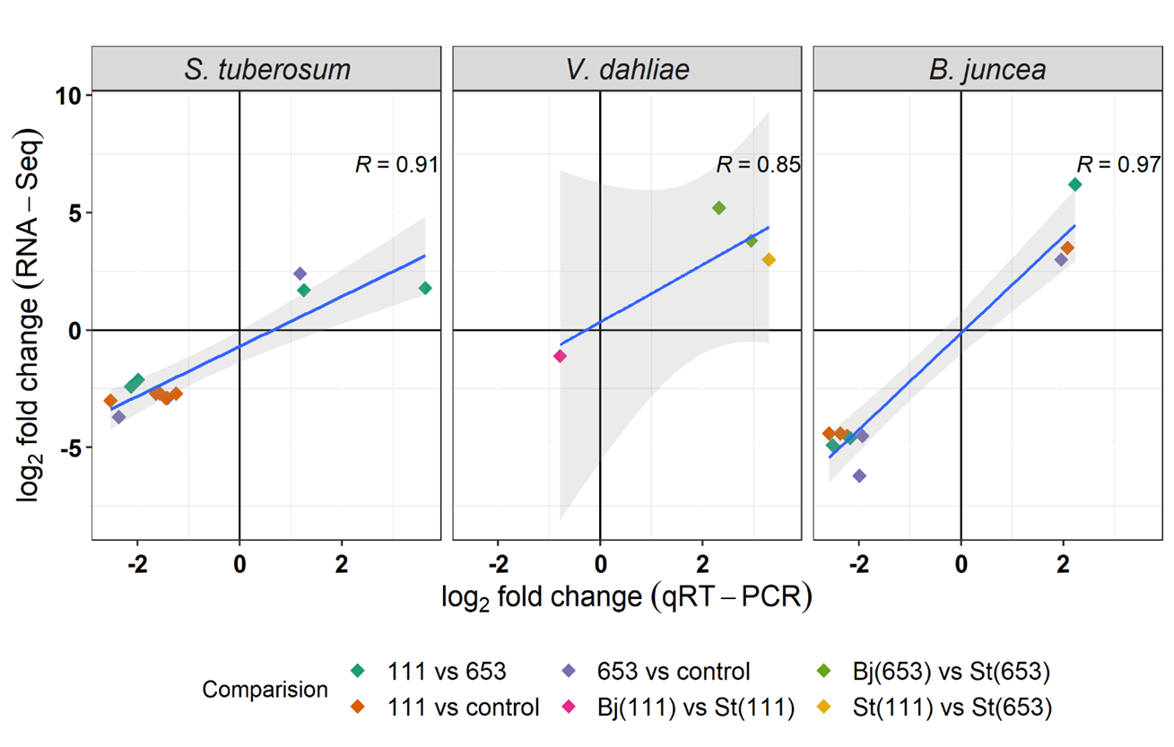
Results
Gene expression changes
Correlation between qRT-PCR and RNA-Seq results

Slide 5
Brassica gene (UAB31_ARATH) with no amplification
qPCR Result
RNA seq results (raw count)

